Slide 1
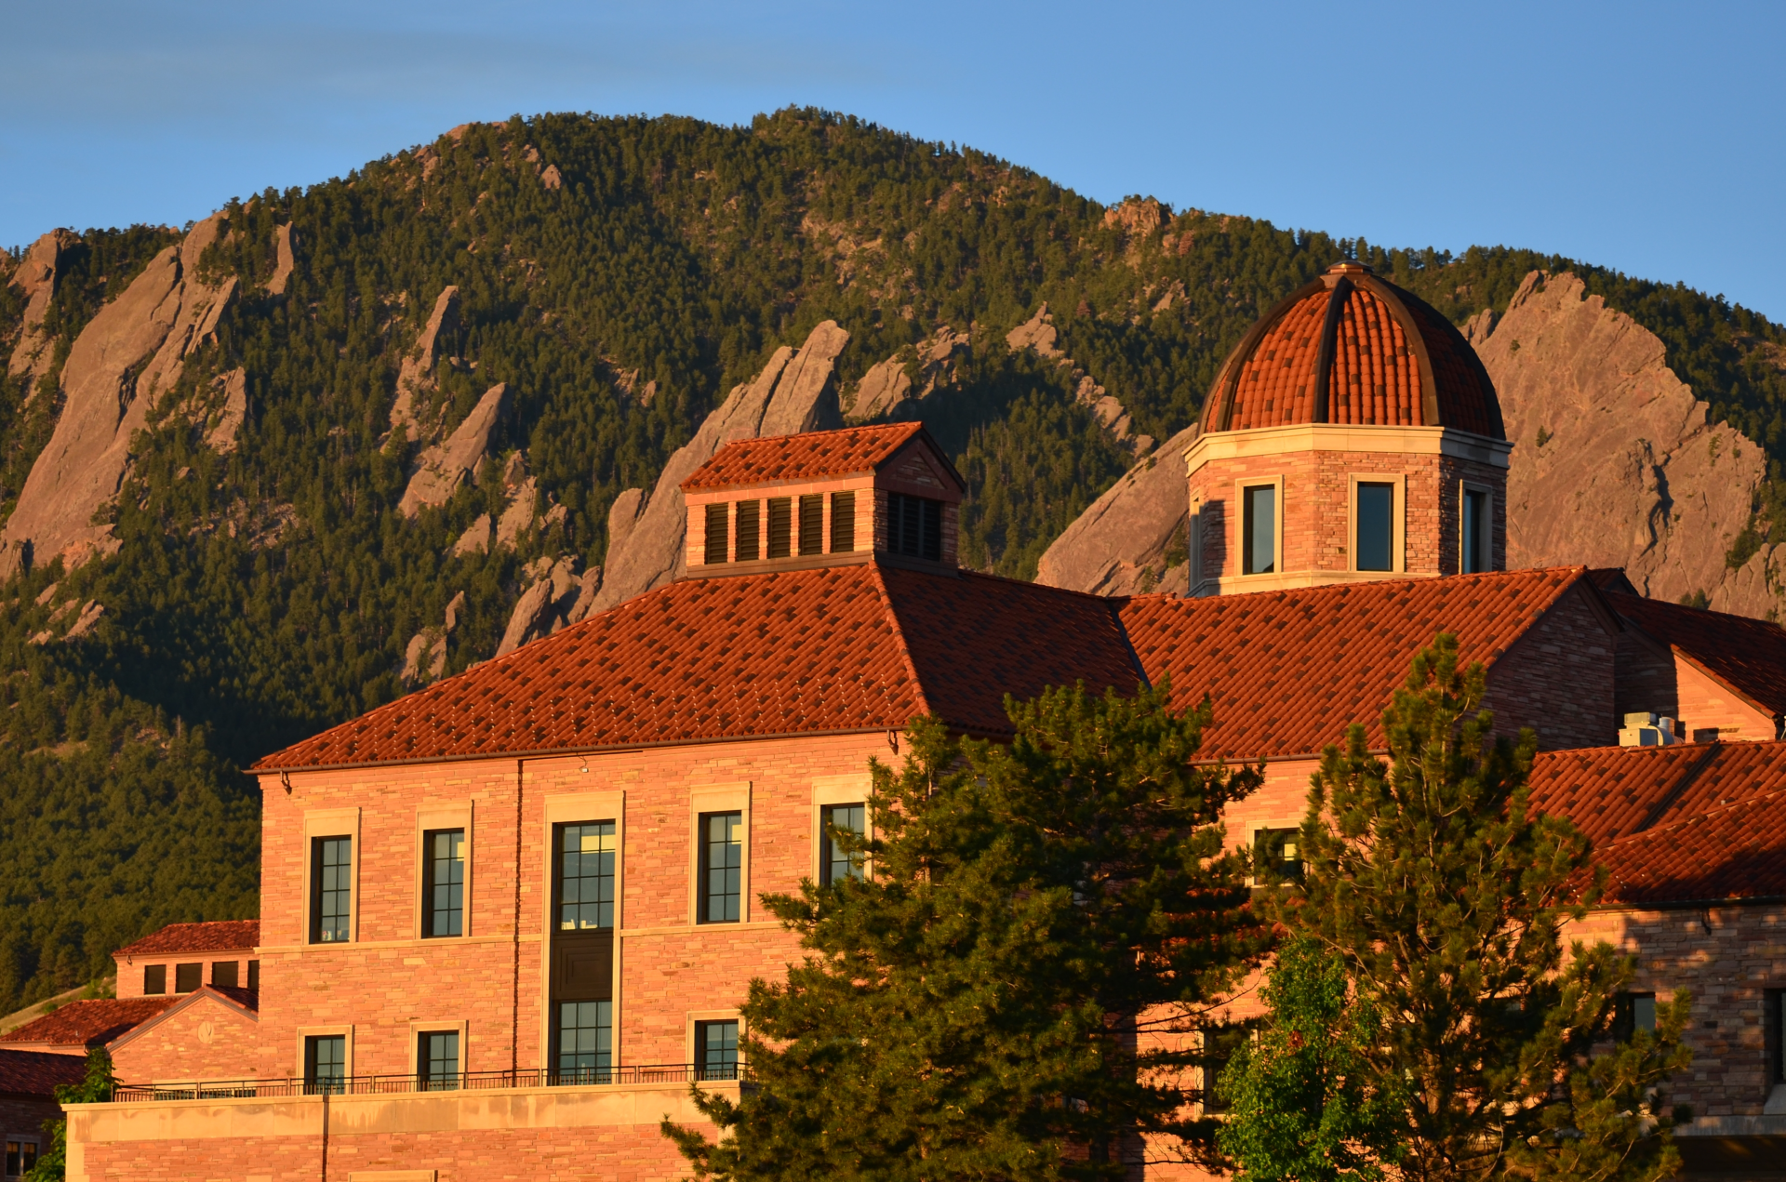
Going Blind to See the Stars: Removing PI Name Decreases Gender Bias in Hubble Proposal Ratings
Stefanie K. Johnson
University of Colorado-Boulder

Slide 2
Background
Gender diversity leads to greater innovation
Women represent only 28% of all S&E occupations
Evidence that bias against women does exist
Institutional forces – gender role expectations and available role models

Slide 3
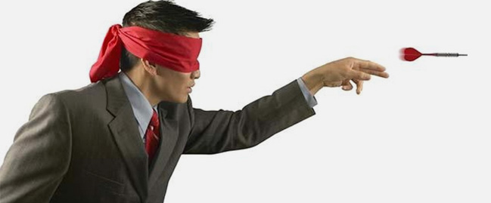
Blinding
Hubble implemented blinding procedure
No studies have tested impact of blinding procedures

Slide 4
Method
Quasi-experimental field study
Investigate the effects of Hubble blinding
Cycle 21 and Cycle 24
Only about 20% of applications receive access
Notes:
2,189 applications

Slide 5
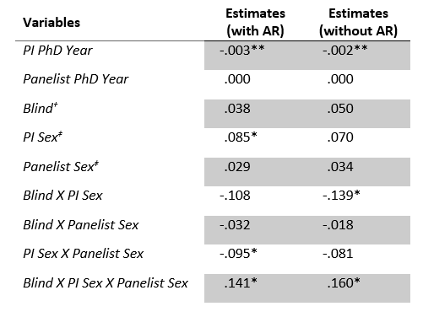

Slide 6
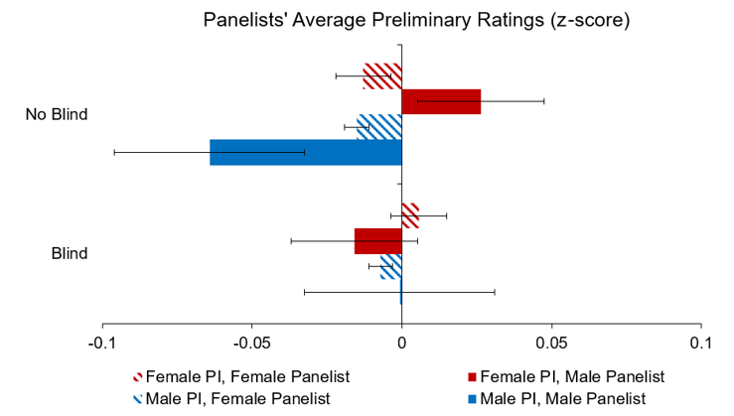

Slide 7
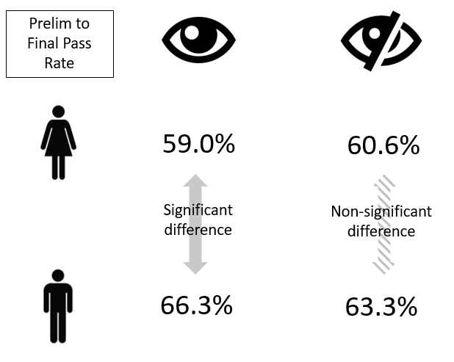

Slide 8
HST Visit
Two researchers attended the 2017 TAC meeting
Qualitative approach
Blinding removed first name (leaving initial) and did not identify PI
Focused on content and tone of conversations

Slide 9
Qualitative Approach
Observed 13 of the 16 panels across three days
Recorded notes on application conversations
Observed that 50% of application conversations include some mention of the PI or team

Slide 10
The PI and Team
“He [referring to the author] is very well qualified”
“My group has benefitted a lot from previous work from this team”
Panel members even pulled up research articles by the team and noted their high citation count

Slide 11
Recommendations
Fully blind the applications
Author guidelines
Separate evaluation of science and management
More training for panel chairs
Training on use of scale and discussions

